Slide 1
UML Class Diagram by Example

Slide 2
A Single Class
Draw a UML class diagram of this class.
public class Student {
public static String idPattern = "[1-9]\d{9}";
private long id;
protected String name;
public String getName( ) { . . . }
public void setName(String aname) { . . . }

Slide 3
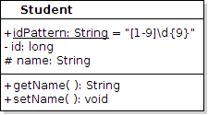
A Single Class
Draw a UML class diagram of this class.

Slide 4
Class with Dependency
A Student uses the Registrar to get his Courses, but he doesn't save a reference to it.
public class Student {
private long id;
//NO Registrar regis;
public double getGpa() {
Registrar regis = Registrar.getInstance();
...

Slide 5
Class with Associations
A Student has an Address and 0 or more Emails.
public class Student {
private long id;
private Address homeAddress;
/** his email addresses. He may have many. */
private List<Email> emails;
Modeling:
Address and Email have complex structure, so model them as objects not as a bunch of String variables.
Why declare emails as List, not ArrayList?
"Program to an interface, not to an implementation."

Slide 6
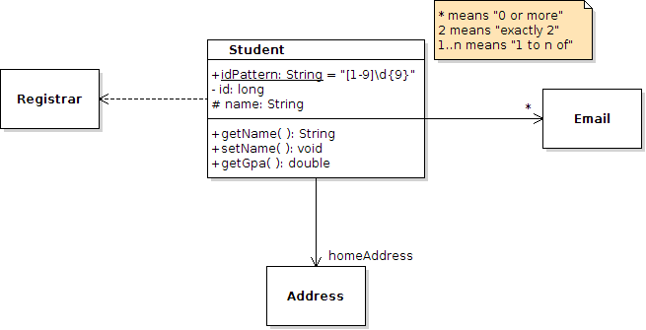
Solution
The line (solid or dashed) and arrowheads have meaning in UML. So, you must use correct notation.

Slide 7
A Student owns his Email Addresses
Composition: A Student owns his Email addresses and when he is deleted we delete his addresses, too!
public class Student {
private long id;
/** student uniquely owns his email addresses*/
private List<Email> emails;
Modeling:
Composition shows "ownership" or "is composed of" (e.g.: a game board is composed of squares).
Only show composition in UML if it has significance to your model. Otherwise, just show as association.

Slide 8
Inheritance
Student is a subclass of Person
public class Student extends Person {

Slide 9
Implements an Interface
Students can be compared to other students
… but not to non-student persons, horses, pizzas, ...
public class Student extends Person
implements Comparable<Student> {

Slide 10
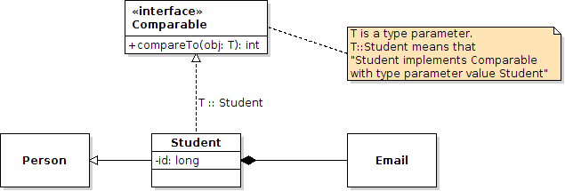
Solution
Black diamond means composition, which is ownership. For interface you should show type parameter in small box in upper-right corner (but this UML editor can't do it).

Slide 11
Reference
UML Distilled, 3rd Edition. Chapter 3 & 5 cover UML class diagrams.

